Slide 1
AGILE WORK ORDERS
FOR SIGNAL SHOP MATERIAL

Slide 2
Work Order sheet
WR#
Parish & TSI#
WO# for Materials entered in Agile
Materials ordered

Slide 3
Log into Lagov. Click Linear Asset tab

Slide 4
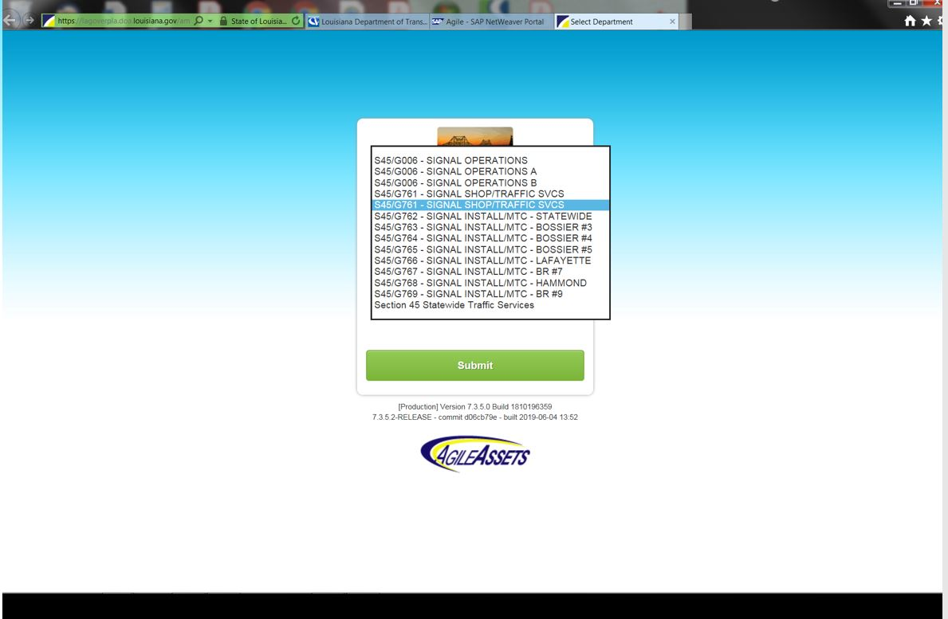
Select Department
Select 2nd
S45/G761

Slide 5
CLICK ON PROGRAM TAB
Click Day Cards

Slide 6
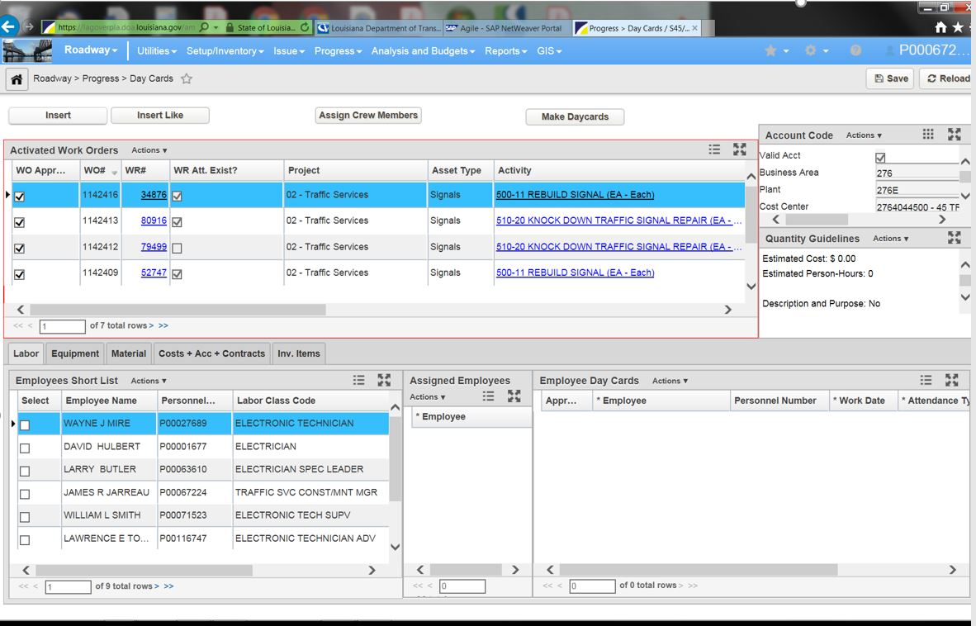
Insert WO
Click Insert

Slide 7
Select WO Attributes drop down and click 02 Traffic Services
Click Next

Slide 8
ASSET TYPE - SIGNALS
Click Next

Slide 9
ACTIVITY-Dropdown/pick type of work. Click NEXT

Slide 10
Inv. Elem. Select Parish -TSI # - Click OK

Slide 11
Attach to WR Right click in WR# tab.
Click Attach to WR

Slide 12
Find WR# Right click in WR#,
Click Find

Slide 13
Find WR#
1 Enter WR#
2 Click Find
3 Click Close
4 Click Select

Slide 14
WO Details – Select Parish, Plan Amount, Crew & WO Priority
Crew
Select Parish
Plan Amount
WO Priority

Slide 15
WO Details
Add Comments
Click Inv. Items
Click Approve
Click Materials tab

Slide 16
Select Materials
Select Material
Add Amount

Slide 17
Make Day cards Right click in Assigned Material
Click Make Day cards

Slide 18
Select Date, Ok & Save
Save
Select Date
OK

Slide 19
WO Approved Check WO approve & Save.
Save

Slide 20
WO Completion
Right click Programs
Select Completion

Slide 21
WO Complete
Check all completed WO
Save

Slide 22
THE END - Go back to Day cards for next WO
Go back to
Day cards

